Slide 1
Two-Dimensional Arrays and Nested Loops – part 2
Barb Ericson
Georgia Institute of Technology
August 2005

Slide 2
Learning Goals
Understand at a conceptual and practical level
  How to create a simpler version of a problem
  How to create an algorithm by solving several concrete examples
    And figuring out what is common in them
  How to translate the algorithm into code
  How to mirror a picture vertically and horizontally

Slide 3


Vertical Mirroring
What if we want to pretend to place a mirror in the middle of the picture
  We would see the left side of the picture mirrored on the right side

Slide 4
Thinking Through Vertical Mirroring
0
1
2
3
4
If we just think of a number at each x and y location instead of a color
  The mirroring would look like this:
Can you find the algorithm to do this?
1 | 2 | 3 | 4 | 5
5 | 4 | 3 | 2 | 1
1 | 2 | 3 | 4 | 5
0
1
2
1 | 2 | 3 | 2 | 1
5 | 4 | 3 | 4 | 5
1 | 2 | 3 | 2 | 1

Slide 5
What is the Vertical Mirror for this?
Try the solve the problem for small samples
If you can’t solve it on a small sample
  You can’t write a program to solve it
0
1
2
1 | 2 | 3
4 | 5 | 6
7 | 8 | 9
0
1
2
0
1
2
0
1
2

Slide 6
Mirror Vertical Algorithm
Loop through all the rows (y starts at 0, increments by 1, and is less than the picture height)
  Loop with x starting at 0 and x less than the midpoint (mirror point) value
    Get the left pixel at x and y
    Get the right pixel at width – 1 - x
    Set the color for the right pixel to be the color of the left pixel
1 | 2 | 3 | 4 | 5
5 | 4 | 3 | 2 | 1
1 | 2 | 3 | 4 | 5
1 | 2 | 3 | 2 | 1
5 | 4 | 3 | 4 | 5
1 | 2 | 3 | 2 | 1

Slide 7
Mirror Vertical Algorithm to Code
We are going to need the midpoint
  int midpoint = this.getWidth() / 2;
Loop through the rows (y values)
  for (int y = 0; y < this.getHeight(); y++) {
  Loop through x values (starting at 1)
  for (int x = 0; x < midpoint; x++) {
    Set right pixel color to left pixel color
      Pixel leftPixel = this.getPixel(x, y);
      Pixel rightPixel = this.getPixel(this.getWidth() - 1 - x, y);
      rightPixel.setColor(leftPixel.getColor());
Notes:
We don’t need to calculate the midpoint every time through the loop so calculate it once before the loop.

Slide 8
Mirror Vertical Method
public void mirrorVertical()
{
int mirrorPoint = this.getWidth() / 2;
Pixel leftPixel = null;
Pixel rightPixel = null;
// loop through the rows
for (int y = 0; y < this.getHeight(); y++)
{
// loop from 0 to just before the mirror point
for (int x = 0; x < mirrorPoint; x++)
{

Slide 9
Mirror Vertical Method - Continued
leftPixel = this.getPixel(x, y);
rightPixel = this.getPixel(this.getWidth() – 1 – x, y);
rightPixel.setColor(leftPixel.getColor());
}
}
}

Slide 10
Using Picture.getMediaPath(fileName)
Gets the full path name for the file with the passed short name
  redMotorcycle.jpg
Defaults to using the directory
  c:\intro-prog-java\mediasources\
Set it to a directory using
  Picture.setMediaPath(“c:/book/media/");
  This will write out the directory name to a file and remember it till you change it
Notes:
The method getMediaPath is a class method in the Picture class.

Slide 11
Trying Mirror Vertical
Create the picture
  Picture p1 = new Picture(
FileChooser.getMediaPath(“caterpillar.jpg”);
Invoke the method on the picture
  p1.mirrorVertical();
Show the picture
  p1.show();

Slide 12

Mirror Horizontal
What about mirroring around a mirror held horizontally in the vertical center of the picture?
  Like a reflection in a lake?

Slide 13
Thinking Through Mirror Horizontal
Again think of a number at each x and y location
  Instead of a color
  And try it with a small sample
How can we write a nested for loop to do this?
0
1
2
1 | 2 | 3
4 | 5 | 6
7 | 8 | 9
0
1
2
0
1
2
0
1 | 2 | 3
4 | 5 | 6
1 | 2 | 3
1
2

Slide 14
What is the Horizontal Mirror for this?
0
1
2
3
4
Try to solve the problem for several small samples problems
See if you can come up with the algorithm to solve it
  Test it more small samples
1 | 2 | 3 | 4 | 5
5 | 4 | 3 | 2 | 1
8 | 9 | 1 | 2 | 3
0
1
2

Slide 15
Mirror Horizontal Algorithm
Get the vertical midpoint
  Picture height / 2
Loop through all the x values
  Loop from y=0 to y < vertical midpoint
    Get the top pixel
      At x and y
    Get the bottom pixel
      Height - 1 - y
    Set the bottom pixel’s color to the top pixel color
1 | 2 | 3
4 | 5 | 6
7 | 8 | 9
1 | 2 | 3
4 | 5 | 6
1 | 2 | 3

Slide 16
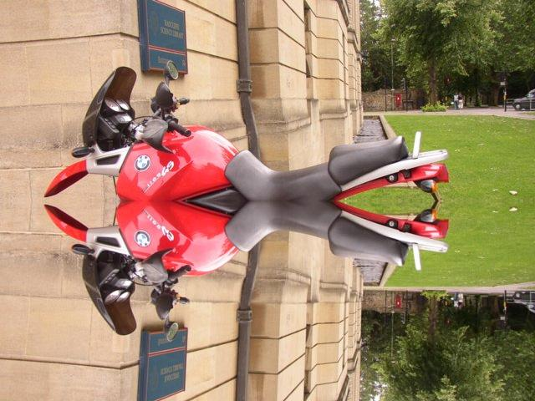
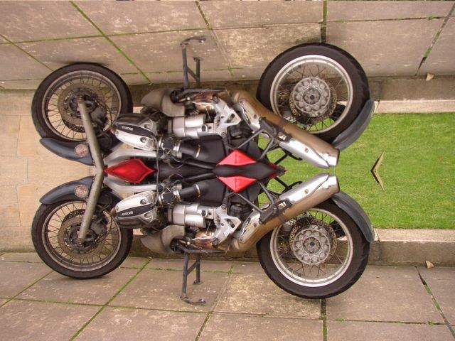
Mirror Horizontal Exercise
Write the method to mirror the top half of the picture to the bottom half.
  This is a motorcycle redMotorcycle.jpg
How about mirroring bottom to top?

Slide 17
Summary
Create several small versions of a problem
  And solve those before you try to code a programming solution
Try to determine the general algorithm from the concrete small versions
Translate the algorithm into code
You can mirror by changing how you loop and how you get the source and target pixels

